Slide 1
Community-Based Care 101
January 2025

Slide 2
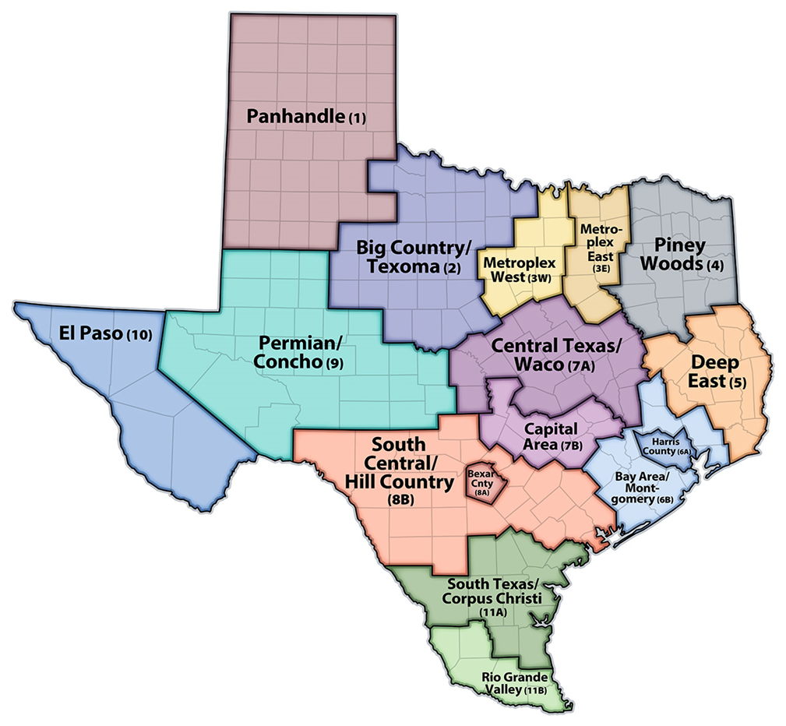
Discussion Topics
Community-Based Care (CBC) Goals and Background
Single Source Continuum Contractor (SSCC) Contract Information
CBC Implementation
CBC Resources

Slide 3
What is Community-Based Care (CBC)?
CBC is Texas’ model of providing foster care services, which gives local communities the flexibility to draw on local strengths and resources and find innovative ways to meet the unique and individual needs of children and their families.
CBC includes many of the services that Child Protective Services (CPS) provided in the DFPS legacy system including foster care, case management, kinship, and reunification services.

Slide 4
What are the Goals of CBC?
The goals of CBC are to:
Increase the number of children and youth placed with their siblings and in their home communities;
Increase the number of children and youth who remain in their school of origin;
Decrease the average time children and youth spend in foster care before achieving positive permanency;
Decrease the number of moves children and youth experience while in foster care;
Decrease the duration and intensity of services that children and youth need while in foster care due to improved well-being and behavioral functioning; and
Create robust and sustainable service continuums in communities throughout Texas.

Slide 5
Legal Basis for CBC
It is the intent of the Texas legislature for DFPS to contract with community providers of child welfare services, including direct case management; Tex. Fam. Code §264.151 and §264.158.
Single Source Continuum Contractors (SSCCs) assume all of the statutory duties of DFPS per Tex. Fam. Code §264.161.
Legal representation in child protection cases is provided in the same manner as DFPS, Tex. Fam. Code §264.163, i.e. represented by the county attorney, district attorney, criminal district attorney, or attorney general per Tex. Fam. Code §264.009.

Slide 6
Community-Based Care Background
Public Private Partnership
Formed in 2010, tasked with creating the model for Foster Care Redesign
Foster Care Redesign
In 2011, Senate Bill 218 codified the PPP’s recommendations and allowed the department to move forward with implementation of the Foster Care Redesign (FCR) model.
Community-Based Care
In 2017, Senate Bill 11, 85th Texas Legislature built off the foundation of the FCR model, to further advance the system through the establishment of CBC. CBC added the case management responsibility to the SSCC contract.

Slide 7
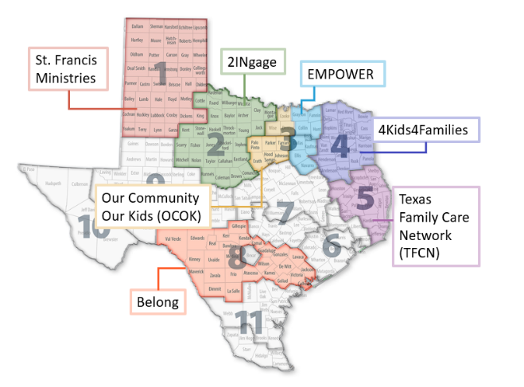
What is a Single Source Continuum Contractor (SSCC)?
A single contractor in each designated geographic area (community area) creates a network of services, foster homes, and other living arrangements and, when ready, provides case management for each child as well.
CPS works with each contractor (SSCC) to carefully manage the transition from traditional foster care to community-based care.

Slide 8
SSCC Applications
Request for Application (RFA) Process
Posted at least once or twice per biennium (2 years)
Community areas follow DFPS regional boundaries
Unsolicited Proposal Process
Proposals to contract for community areas outside of a posted RFA are allowed per Texas Family Code §264.157(b)
Posted on the HHSC webpage
Communities select their area (contiguous counties, keep county boundaries, and encouraged to keep judicial boundaries)
Only in areas not currently under an SSCC
Applicant must be either a non-profit with majority of the board residing in Texas or a governmental entity
Applicant Requirement

Slide 9
CBC Contract Information
Performance Measures
Contract performance measures tie back to child safety, permanency, and wellbeing.
Additional performance measures (for Stage II) include % of children and youth that attend school in their school of origin and the percentage of children/youth that are placed with kin.
Stage III, financial incentives and remedies tied directly to time child spends in paid foster care before exiting to reunification, kinship, or adoptive placement.
Monitoring and Oversight
Multi-Disciplinary Team approach to monitoring:
CBC Contract manager is responsible for ensuring contract adherence, fiscal monitoring, and oversight of contractor performance in collaboration with the multi-disciplinary team.
Regional CBC Administrator (CBCA), oversees implementation in each area and tracks case specific issues to resolutions. Noted trends are elevated to contract manager to address.
DFPS Office of Data and Systems Improvement program supports Continuous Quality Improvement strategies in the community area, through monthly and quarterly data reviews with DFPS and SSCC.
Case Management Oversight (CMO) staff complete case reads in order to support case management oversight and provide technical assistance.
SSCC contracts have a five-year term with an optional one-time five-year renewal.
Notes:
Note on Stage III- it is a performance indicator but not a true measure

Slide 10
Stages of CBC Implementation
Stage I
The SSCC is responsible for ensuring the full continuum of paid foster care services, including placement, as well as Preparation for Adult Living (PAL) Life Skills Training and purchased adoption services. *Stage I has 6 months of readiness; after go-live, in Stage I for 6 months.
The SSCC continues responsibility for all Stage I services and becomes responsible for the provision of all substitute care services (kinship, reunification, etc.), Interstate Compact on the Placement of Children (ICPC), as well as all case management services, such as establishing the permanency goal for the family, face-to-face visits with children and families, permanency/case planning activities, court activities, kinship services, etc. *Stage II has 6 months of readiness.
Stage III
The provision of services outlined in Stage I and II and financial accountability through the use of incentives and remedies for the timely achievement of permanency for children. The advancement from Stage II to Stage III will occur 18 months after the SSCC begins serving all children and families in the community area (18 months post Stage II go-live). Note: Incentives distributed must be reinvested to improve the quality of care to youth.
Stage II
*Entry into each stage is subject to a review of readiness by DFPS and OCBCT.
Notes:
Stage III uses child-level data to establish a baseline for positive foster care exits and paid foster care days, their length of stay, and compares the baseline to actual performance.
If an SSCC uses fewer foster care days, thus decreasing time to one of the three types of non-paid settings, an incentive is earned. The general revenue portion of the foster care reimbursement that would have been paid based on baseline projections continues to be paid to be reinvested to improve the quality of care.

Slide 11
Community-Based Care:
Stage II SSCC Performance Measures
Safety | For children not to experience abuse, neglect, or exploitation while in foster care.
Stability | To minimize the number of placement moves in foster care.
Home Settings | For children to live in home settings.
Proximity | For children to live within 50 miles of their home.
Sibling Groups | For sibling groups to be placed together.
Preparation for Adult Living | For youth who will age out of care to be prepared for adult living.
Kinship | For children to be placed with kin.
Texas ID / DL | Youth 16 and older access to a State ID / Driver’s License
Permanency/Reunification | Reduce children’s time in care.
Re-Intervention | Reduce future CPS intervention for children who exit care.
11

Slide 12
CBC Implementation- January 2025
R1 - Saint Francis - Stage III
R2 - 2INgage - Stage III
R3W - OCOK - Stage III (southern 7 counties), and Stage II (Cooke, Denton, and Wise)
R3E - EMPOWER- Stage II
R4 - 4Kids4Families - Stage II
R5 - TFCN - Stage II
R8B - Belong - Stage III

Slide 13
CBC Future Implementation and Enhancements
Current Procurement Activities:
RFA for 6A, 6B, 8A, (10) was released on March 1, 2024.
Responses were received for Regions 6A, 6B, and 8A; however, no responses were received for Region 10.
Negotiations with respondents are underway.
Interagency Contract (IAC) with University of Texas at Austin for CBC Process Evaluation to understand the strengths and challenges of implementing CBC in Regions 1, 2, 3W, and 8B
Request for Information (RFI) for R9 and R10
Closed September 3, 2024. Provides crucial stakeholder feedback to inform the implementation of CBC in these rural regions.
Future Procurement Plans:
Legislative Appropriations Request includes funding request for Regions 7A, 7B, 11A, and 11B
Unsolicited Proposals for Region 7A:
Three were received in Fall 2024. DFPS will move to a competitive procurement/RFA

Slide 14
CBC Implementation Moving Forward

Slide 15
Resources
CBC Webpage: Current events and reports, SSCC and DFPS contact information, request a presentation (www.communitybasedcare.org)
CBC Concerns or Complaints: CBCComplaints@dfps.texas.gov
General CBC Inquiries: CBCare@dfps.Texas.gov

Slide 16
Thank You
Community-Based Care Operations
Hollie Mims
Hollie.Mims@dfps.Texas.gov
512-239-9657

